Slide 1

Natural Language Processing
Yue Zhang
Westlake University

Slide 2
Chapter 4
Discriminative Linear Classifiers

Slide 3
Contents
4.1 Log-Linear Models
4.1.1 Training binary log-linear models
4.1.2 Training multi-class log-linear models
4.1.3 Using log-linear models for classification
4.2 SGD training of SVMs
4.2.1 Binary classification
4.2.2 A perceptron training objective function
4.3 A Generalized Linear Model for Classification
4.3.1 Unified Online Training
4.3.2 Loss Functions
4.3.3 Regularization
4.4 Working with Multiple Models
4.4.1 Comparing model performances
4.4.2 Ensemble models

Slide 4
Contents
4.1 Log-Linear Models
4.1.1 Training binary log-linear models
4.1.2 Training multi-class log-linear models
4.1.3 Using log-linear models for classification
4.2 SGD training of SVMs
4.2.1 Binary classification
4.2.2 A perceptron training objective function
4.3 A Generalized Linear Model for Classification
4.3.1 Unified Online Training
4.3.2 Loss Functions
4.3.3 Regularization
4.4 Working with Multiple Models
4.4.1 Comparing model performances
4.4.2 Ensemble models

Slide 5
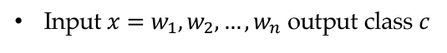
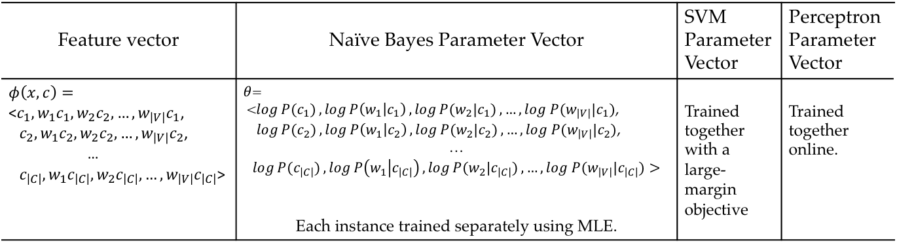
Review linear models
Input $x=w_{1},w_{2},…,w_{n}$ output class $c$
Feature vector | Naïve Bayes Parameter Vector | SVM Parameter Vector | Perceptron Parameter Vector
$$φ\left(x,c\right)=$$ <$c_{1},w_{1}c_{1},w_{2}c_{2},…,w_{\left|V\right|}c_{1}$, $c_{2},w_{1}c_{2},w_{2}c_{2},…,w_{\left|V\right|}c_{2}$, … $c_{\left|C\right|},w_{1}c_{\left|C\right|},w_{2}c_{\left|C\right|},…,w_{\left|V\right|}c_{\left|C\right|}$> | $θ$= <$\log{P(c_{1})},\log{P\left(w_{1} | c_{1}\right)},\log{P(w_{2}|c_{1})},…,log P(w_{\left|V\right|}|c_{1})$, $\log{P(c_{2})},\log{P\left(w_{1} | c_{2}\right)},\log{P(w_{2}|c_{2})},…,log P(w_{\left|V\right|}|c_{2})$, … $\log{P(c_{\left|C\right|})},\log{P\left(w_{1} | c_{\left|C\right|}\right)},\log{P(w_{2}|c_{\left|C\right|})},…,log P(w_{\left|V\right|}|c_{\left|C\right|})>$ Each instance trained separately using MLE. | Trained together with a large-margin objective | Trained together online.

Slide 6
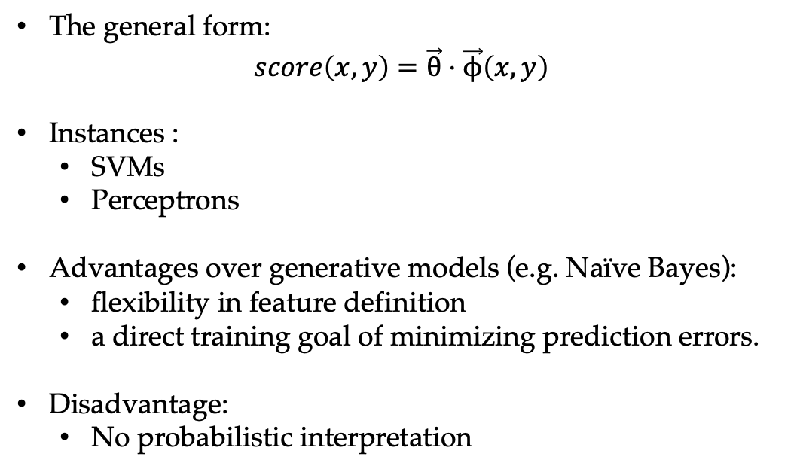
Discriminative linear classifiers
The general form:
$$score\left(x,y\right)=\vec{θ}⋅\vec{ϕ}\left(x,y\right)$$
Instances :
SVMs
Perceptrons
Advantages over generative models (e.g. Naïve Bayes):
flexibility in feature definition
a direct training goal of minimizing prediction errors.
Disadvantage:
No probabilistic interpretation
Notes:
What it Phi

Slide 7
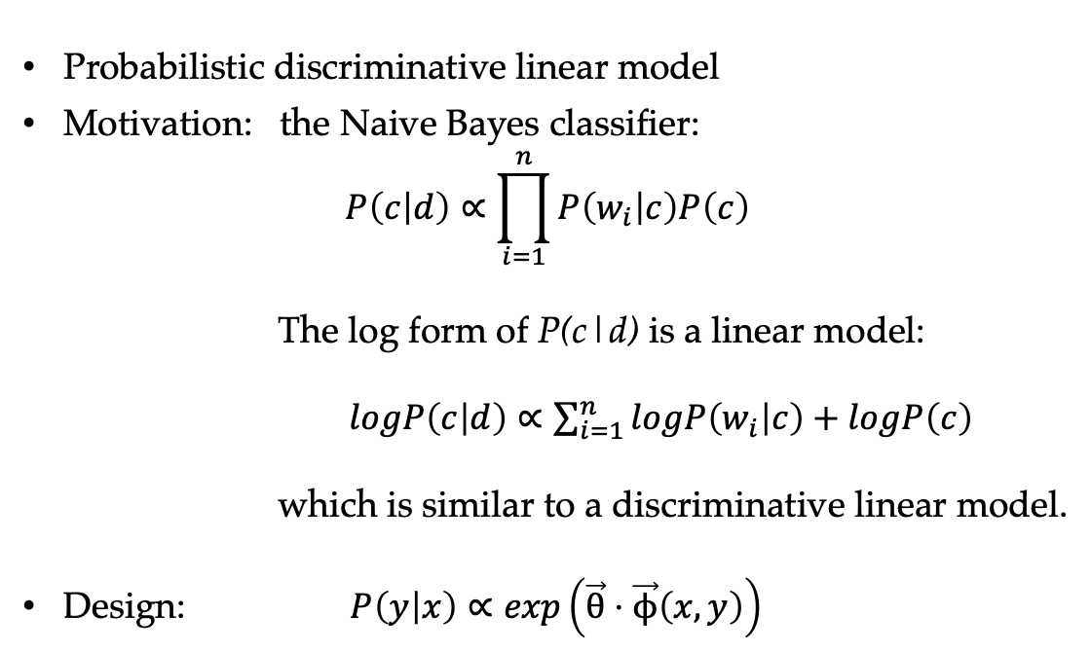
Log-linear Models
Probabilistic discriminative linear model
Motivation: the Naive Bayes classifier:
$$P\left(c | d\right)∝\prod_{i=1}^{n}{P\left(w_{i} | c\right)P\left(c\right)}$$
The log form of P(c|d) is a linear model:
$logP\left(c | d\right)∝\sum_{i=1}^{n}{logP\left(w_{i} | c\right)}+logP\left(c\right)$
which is similar to a discriminative linear model.
Design: $P\left(y | x\right)∝\exp\left(\vec{θ}⋅\vec{ϕ}\left(x,y\right)\right)$

Slide 8
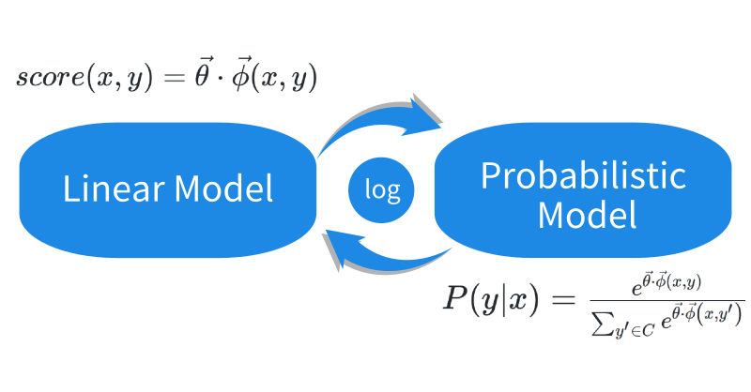
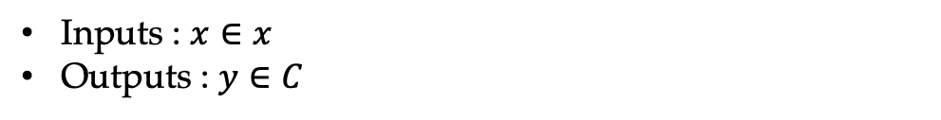
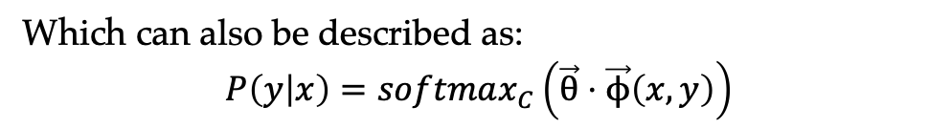
Log-linear model for multi-class classification
Inputs : $x∈x$
Outputs : $y∈C$
Which can also be described as:
$$P\left(y | x\right)=softmax_{C}\left(\vec{θ}⋅\vec{ϕ}\left(x,y\right)\right)$$

Slide 9
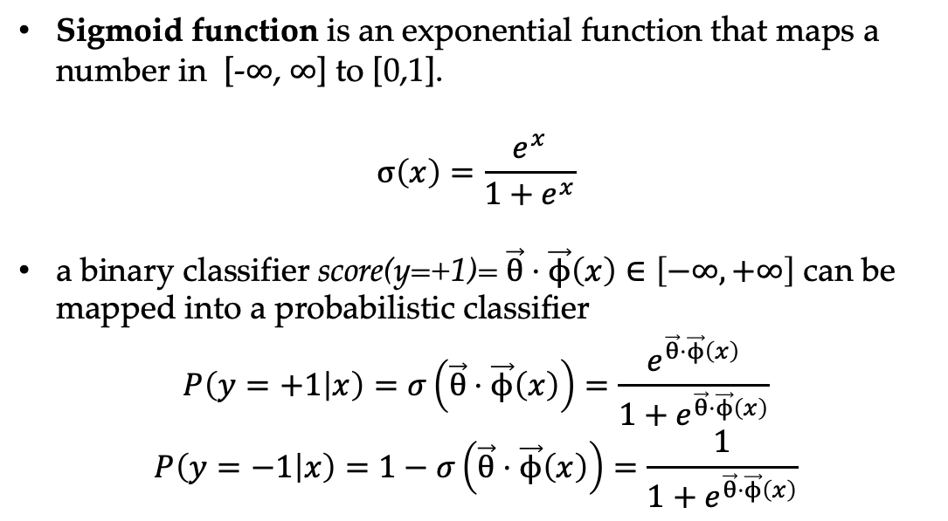
Log-linear model for binary classification
Sigmoid function is an exponential function that maps a number in [-$∞$, $∞$] to [0,1].
$$σ\left(x\right)=\frac{e^{x}}{1+e^{x}}$$
a binary classifier score(y=+1)= $\vec{θ}⋅\vec{ϕ}\left(x\right)∈\left[−∞,+∞\right]$ can be mapped into a probabilistic classifier
$$P\left(y=+1 | x\right)=σ\left(\vec{θ}⋅\vec{ϕ}\left(x\right)\right)=\frac{e^{\vec{θ}⋅\vec{ϕ}\left(x\right)}}{1+e^{\vec{θ}⋅\vec{ϕ}\left(x\right)}}$$
$$P\left(y=−1 | x\right)=1−σ\left(\vec{θ}⋅\vec{ϕ}\left(x\right)\right)=\frac{1}{1+e^{\vec{θ}⋅\vec{ϕ}\left(x\right)}}$$

Slide 10
Contents
4.1 Log-Linear Models
4.1.1 Training binary log-linear models
4.1.2 Training multi-class log-linear models
4.1.3 Using log-linear models for classification
4.2 SGD training of SVMs
4.2.1 Binary classification
4.2.2 A perceptron training objective function
4.3 A Generalized Linear Model for Classification
4.3.1 Unified Online Training
4.3.2 Loss Functions
4.3.3 Regularization
4.4 Working with Multiple Models
4.4.1 Comparing model performances
4.4.2 Ensemble models

Slide 11
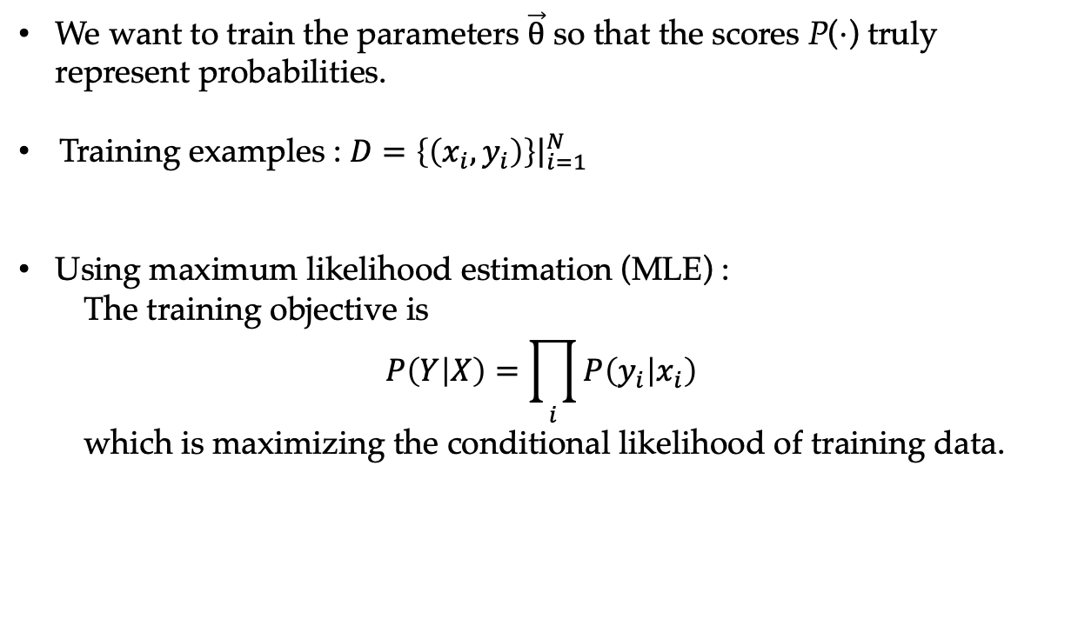
Training log-linear models
We want to train the parameters $\vec{θ}$ so that the scores P($⋅$) truly represent probabilities.
Training examples : $D={\left.\left\{\left(x_{i},y_{i}\right)\right\}\right|}_{i=1}^{N}$
Using maximum likelihood estimation (MLE) :
The training objective is
$$P\left(Y | X\right)=\prod_{i}{P\left(y_{i} | x_{i}\right)}$$
which is maximizing the conditional likelihood of training data.

Slide 12
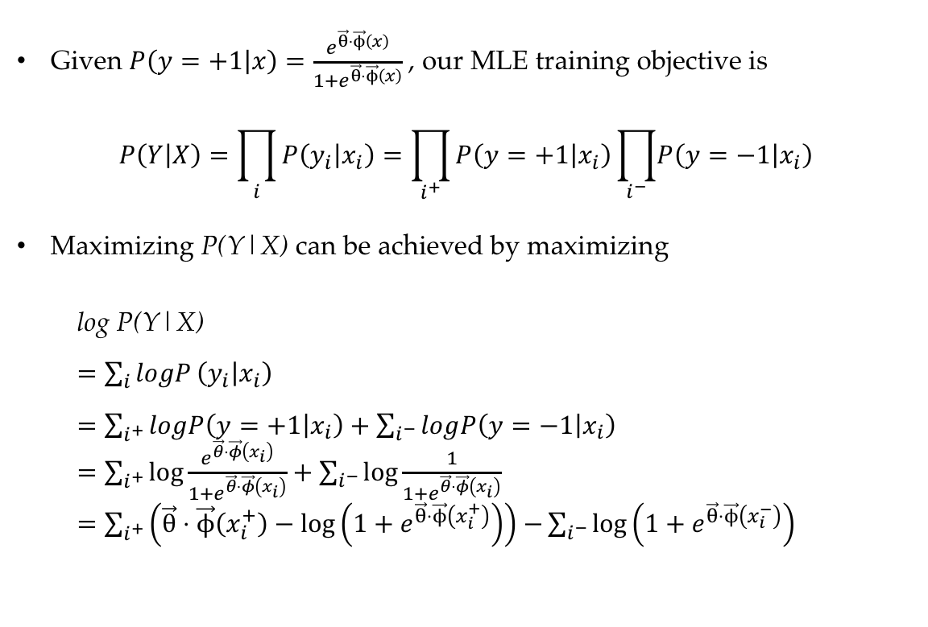
Training binary log-linear models
Given $P\left(y=+1 | x\right)=\frac{e^{\vec{θ}⋅\vec{ϕ}\left(x\right)}}{1+e^{\vec{θ}⋅\vec{ϕ}\left(x\right)}}$ , our MLE training objective is
$$P\left(Y | X\right)=\prod_{i}{P\left(y_{i} | x_{i}\right)}=\prod_{i^{+}}{P\left(y=+1 | x_{i}\right)\prod_{i^{−}}{\left.P\left(y=−1 | x_{i}\right)\right.}}$$
Maximizing P(Y|X) can be achieved by maximizing
log P(Y|X)
$=\sum_{i}{logP}\left(y_{i} | x_{i}\right)$
$=\sum_{i^{+}}{logP\left(y=+1 | x_{i}\right)}+\sum_{i^{−}}{log\left.P\left(y=−1 | x_{i}\right)\right.}$
$=\sum_{i^{+}}{\log{\frac{e^{\vec{θ}⋅\vec{φ}\left(x_{i}\right)}}{1+e^{\vec{θ}⋅\vec{φ}\left(x_{i}\right)}}}}+\sum_{i^{−}}{\log{\frac{1}{1+e^{\vec{θ}⋅\vec{φ}\left(x_{i}\right)}}}}$
$=\sum_{i^{+}}{\left(\vec{θ}⋅\vec{ϕ}\left(x_{i}^{+}\right)−\log\left(1+e^{\vec{θ}⋅\vec{ϕ}\left(x_{i}^{+}\right)}\right)\right)}$ $−\sum_{i^{−}}{\log\left(1+e^{\vec{θ}⋅\vec{ϕ}\left(x_{i}^{−}\right)}\right)}$

Slide 13
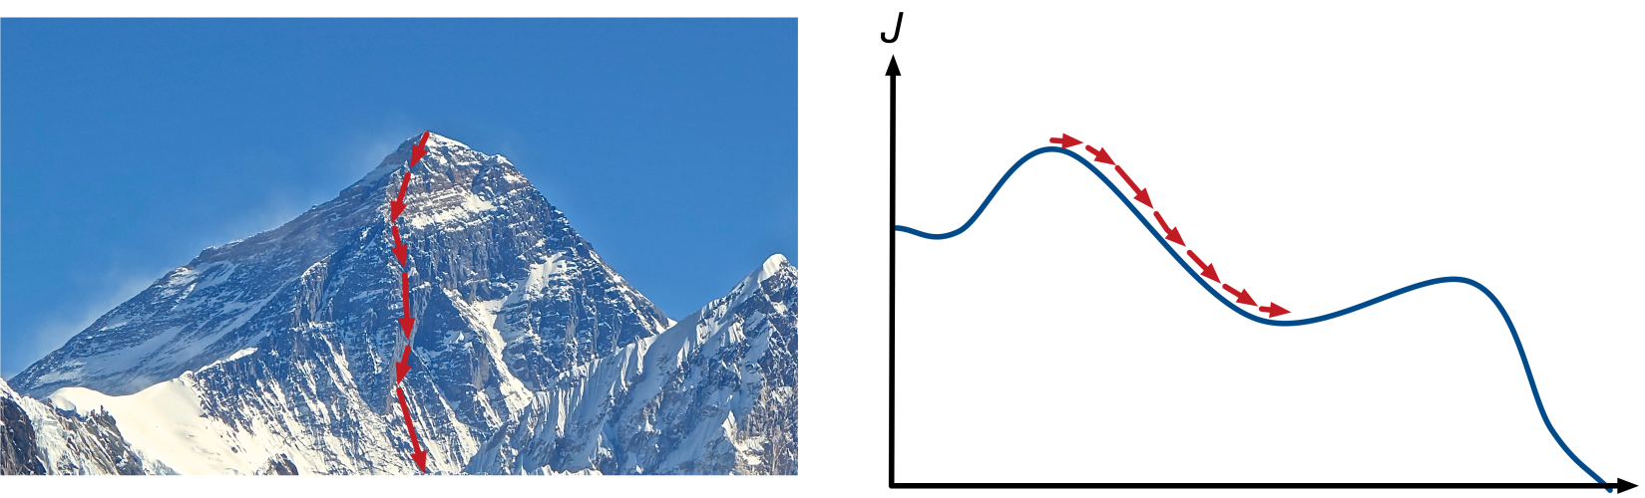
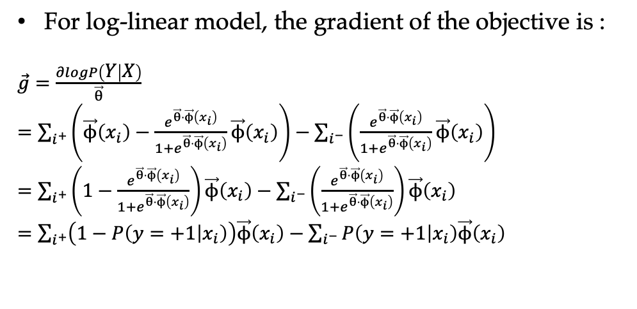
Gradient descent
For log-linear model, the gradient of the objective is :
$\vec{g}=\frac{∂logP\left(Y | X\right)}{\vec{θ}}$
$=\sum_{i^{+}}{\left(\vec{ϕ}\left(x_{i}\right)−\frac{e^{\vec{θ}⋅\vec{ϕ}\left(x_{i}\right)}}{1+e^{\vec{θ}⋅\vec{ϕ}\left(x_{i}\right)}}\vec{ϕ}\left(x_{i}\right)\right)}−\sum_{i^{−}}{\left(\frac{e^{\vec{θ}⋅\vec{ϕ}\left(x_{i}\right)}}{1+e^{\vec{θ}⋅\vec{ϕ}\left(x_{i}\right)}}\vec{ϕ}\left(x_{i}\right)\right)}$
$=\sum_{i^{+}}{\left(1−\frac{e^{\vec{θ}⋅\vec{ϕ}\left(x_{i}\right)}}{1+e^{\vec{θ}⋅\vec{ϕ}\left(x_{i}\right)}}\right)\vec{ϕ}\left(x_{i}\right)}−\sum_{i^{−}}{\left(\frac{e^{\vec{θ}⋅\vec{ϕ}\left(x_{i}\right)}}{1+e^{\vec{θ}⋅\vec{ϕ}\left(x_{i}\right)}}\right)\vec{ϕ}\left(x_{i}\right)}$
$=\sum_{i^{+}}{\left(1−P\left(y=+1 | x_{i}\right)\right)\vec{ϕ}\left(x_{i}\right)}−\sum_{i^{−}}{P\left(y=+1 | x_{i}\right)\vec{ϕ}\left(x_{i}\right)}$

Slide 14
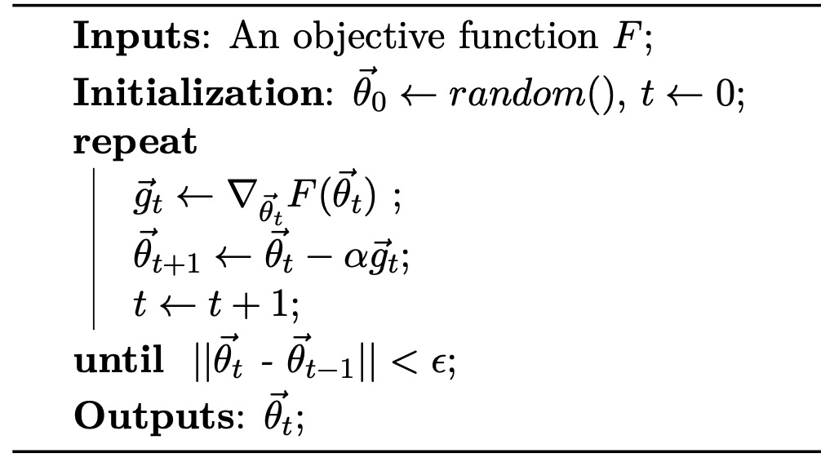
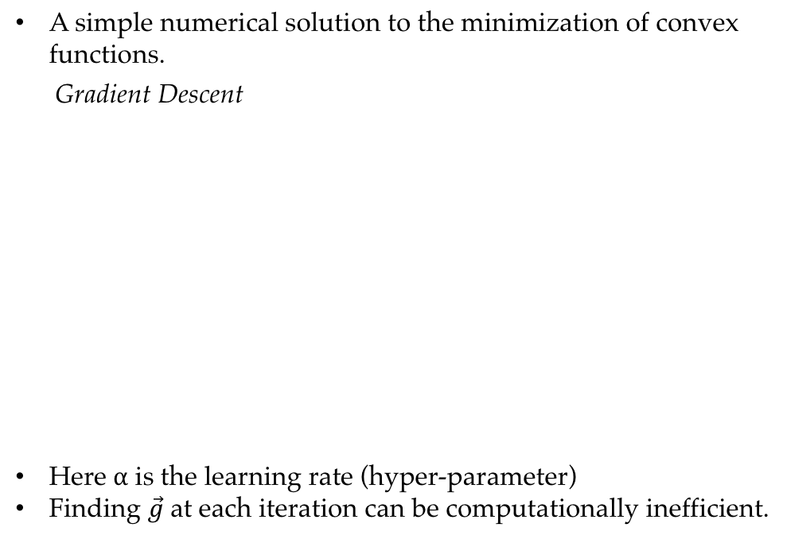
Gradient descent
A simple numerical solution to the minimization of convex functions.
Gradient Descent
Here $α$ is the learning rate (hyper-parameter)
Finding $\vec{g}$ at each iteration can be computationally inefficient.

Slide 15
Gradient descent
General numerical optimization method. SVM can be optimized with gradient descent too.
Converges to a local minimum dependent on the initialization.
Can be slow when the number of training instances N is large.

Slide 16
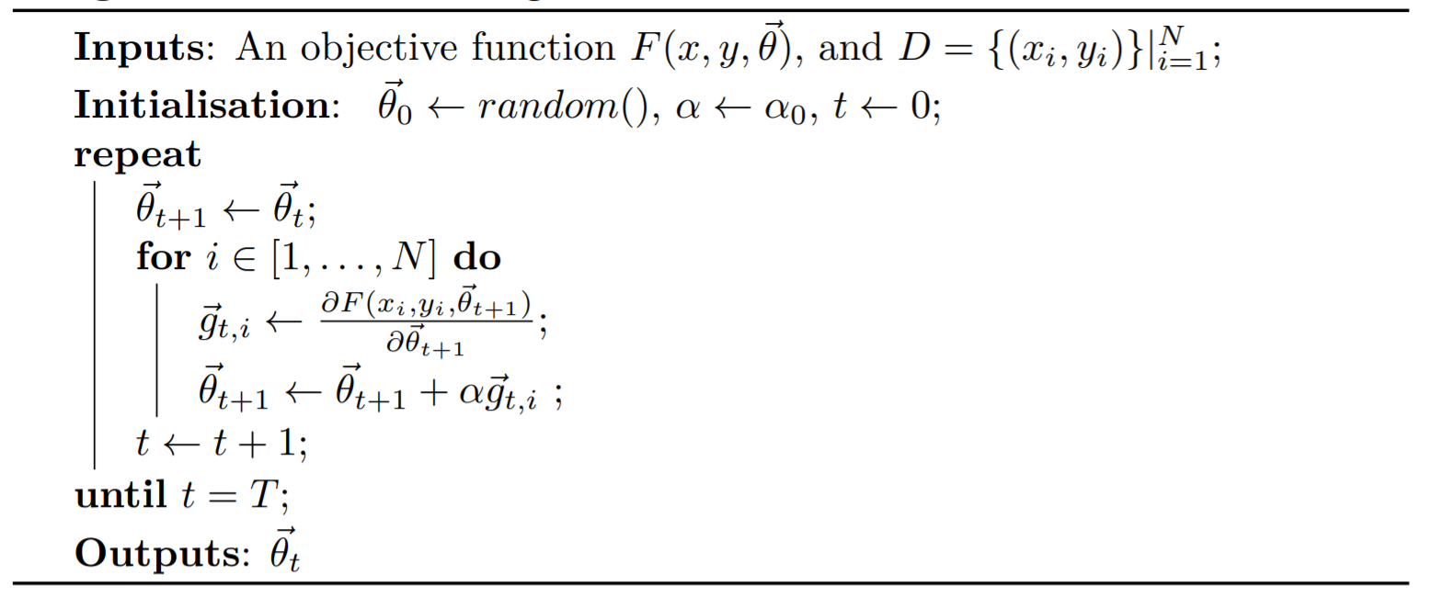
Stochastic gradient descent (SGD)
Stochastic Gradient Descent
SGD updates model parameters more frequently, and converge much faster than gradient descents
Notes:
Algorithm 4.1-4.3

Slide 17
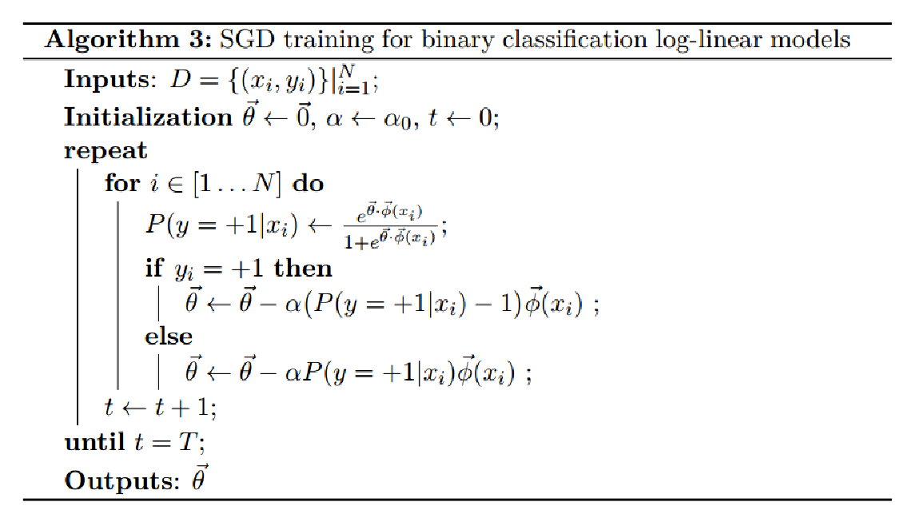
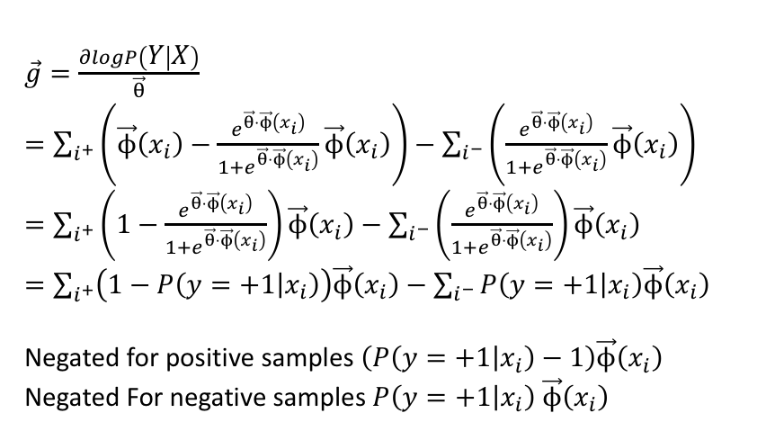
Stochastic gradient descent (SGD)
SGD for binary classification log-linear model
$\vec{g}=\frac{∂logP\left(Y | X\right)}{\vec{θ}}$
$=\sum_{i^{+}}{\left(\vec{ϕ}\left(x_{i}\right)−\frac{e^{\vec{θ}⋅\vec{ϕ}\left(x_{i}\right)}}{1+e^{\vec{θ}⋅\vec{ϕ}\left(x_{i}\right)}}\vec{ϕ}\left(x_{i}\right)\right)}−\sum_{i^{−}}{\left(\frac{e^{\vec{θ}⋅\vec{ϕ}\left(x_{i}\right)}}{1+e^{\vec{θ}⋅\vec{ϕ}\left(x_{i}\right)}}\vec{ϕ}\left(x_{i}\right)\right)}$
$=\sum_{i^{+}}{\left(1−\frac{e^{\vec{θ}⋅\vec{ϕ}\left(x_{i}\right)}}{1+e^{\vec{θ}⋅\vec{ϕ}\left(x_{i}\right)}}\right)\vec{ϕ}\left(x_{i}\right)}−\sum_{i^{−}}{\left(\frac{e^{\vec{θ}⋅\vec{ϕ}\left(x_{i}\right)}}{1+e^{\vec{θ}⋅\vec{ϕ}\left(x_{i}\right)}}\right)\vec{ϕ}\left(x_{i}\right)}$
$=\sum_{i^{+}}{\left(1−P\left(y=+1 | x_{i}\right)\right)\vec{ϕ}\left(x_{i}\right)}−\sum_{i^{−}}{P\left(y=+1 | x_{i}\right)\vec{ϕ}\left(x_{i}\right)}$
Negated for positive samples $\left(P\left(y=+1 | x_{i}\right)−1\right)\vec{ϕ}\left(x_{i}\right)$
Negated For negative samples $P\left(y=+1 | x_{i}\right)$ $\vec{ϕ}\left(x_{i}\right)$

Slide 18
Contents
4.1 Log-Linear Models
4.1.1 Training binary log-linear models
4.1.2 Training multi-class log-linear models
4.1.3 Using log-linear models for classification
4.2 SGD training of SVMs
4.2.1 Binary classification
4.2.2 A perceptron training objective function
4.3 A Generalized Linear Model for Classification
4.3.1 Unified Online Training
4.3.2 Loss Functions
4.3.3 Regularization
4.4 Working with Multiple Models
4.4.1 Comparing model performances
4.4.2 Ensemble models

Slide 19
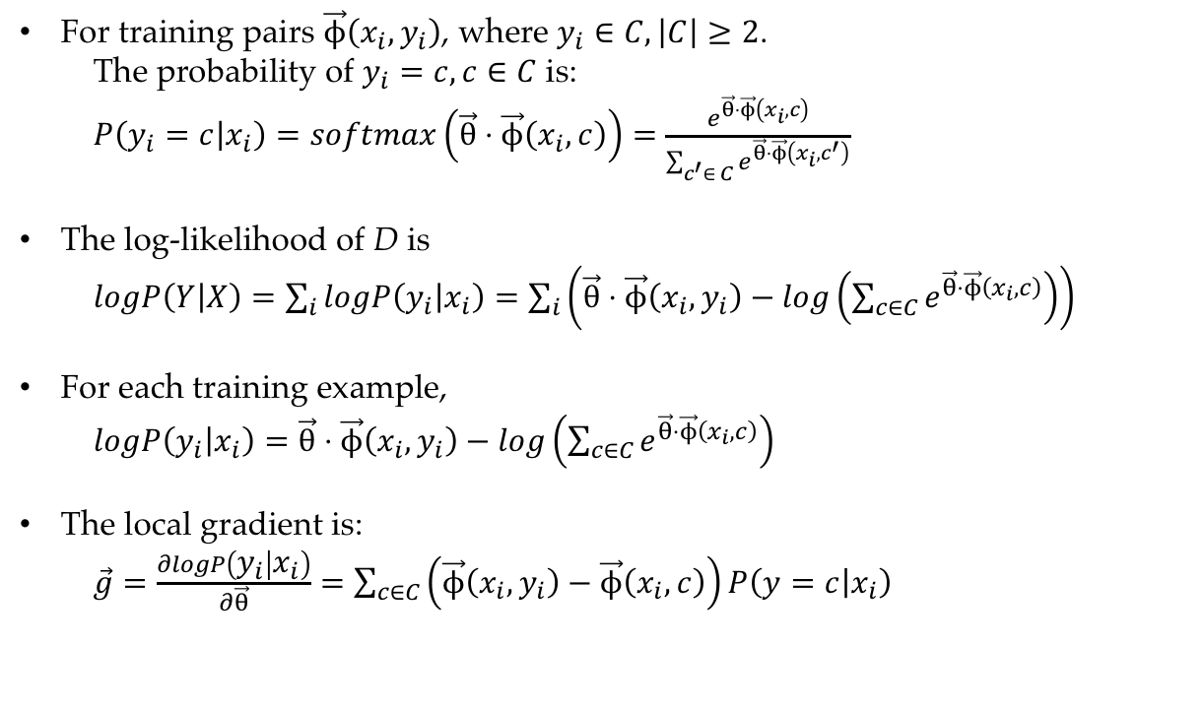
Multi-class log-linear models
For training pairs $\vec{ϕ}\left(x_{i},y_{i}\right)$, where $y_{i}∈C,\left|C\right|≥2$.
The probability of $y_{i}=c,c∈C$ is:
$P\left(y_{i}=c | x_{i}\right)=softmax\left(\vec{θ}⋅\vec{ϕ}\left(x_{i},c\right)\right)=\frac{e^{\vec{θ}⋅\vec{ϕ}\left(x_{i},c\right)}}{\sum_{c^{′}∈ C}{e^{\vec{θ}⋅\vec{ϕ}\left(x_{i},c^{′}\right)}}}$
The log-likelihood of D is
$logP\left(Y | X\right)=\sum_{i}{logP\left(y_{i} | x_{i}\right)}=\sum_{i}{\left(\vec{θ}⋅\vec{ϕ}\left(x_{i},y_{i}\right)−log\left(\sum_{c∈C}{e^{\vec{θ}⋅\vec{ϕ}\left(x_{i},c\right)}}\right)\right)}$
For each training example,
$logP\left(y_{i} | x_{i}\right)=\vec{θ}⋅\vec{ϕ}\left(x_{i},y_{i}\right)−log\left(\sum_{c∈C}{e^{\vec{θ}⋅\vec{ϕ}\left(x_{i},c\right)}}\right)$
The local gradient is:
$\vec{g}=\frac{∂logP\left(y_{i} | x_{i}\right)}{∂\vec{θ}}=\sum_{c∈C}{\left(\vec{ϕ}\left(x_{i},y_{i}\right)−\vec{ϕ}\left(x_{i},c\right)\right)P\left(y=c | x_{i}\right)}$

Slide 20
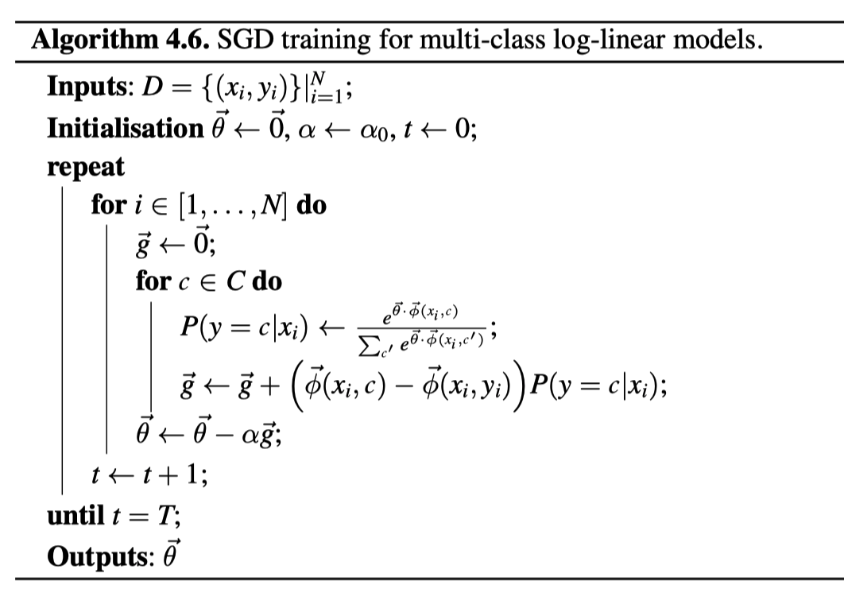
Multi-class log-linear models
SGD training for multi-class log-linear models

Slide 21
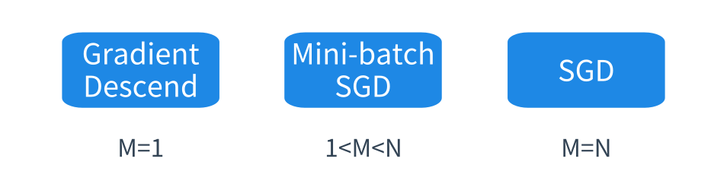
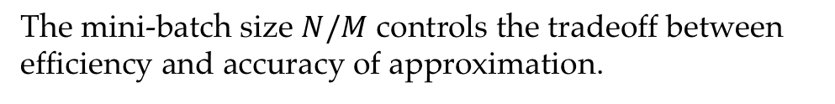
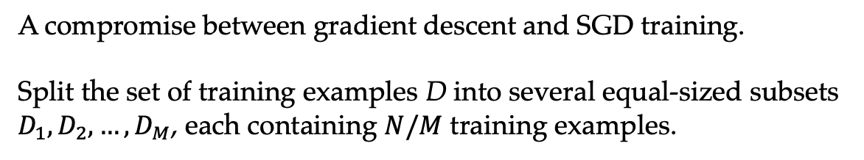
Mini-batch SGD
A compromise between gradient descent and SGD training.
Split the set of training examples D into several equal-sized subsets $D_{1},D_{2},…,D_{M}$, each containing $N/M$ training examples.
The mini-batch size $N/M$ controls the tradeoff between efficiency and accuracy of approximation.

Slide 22
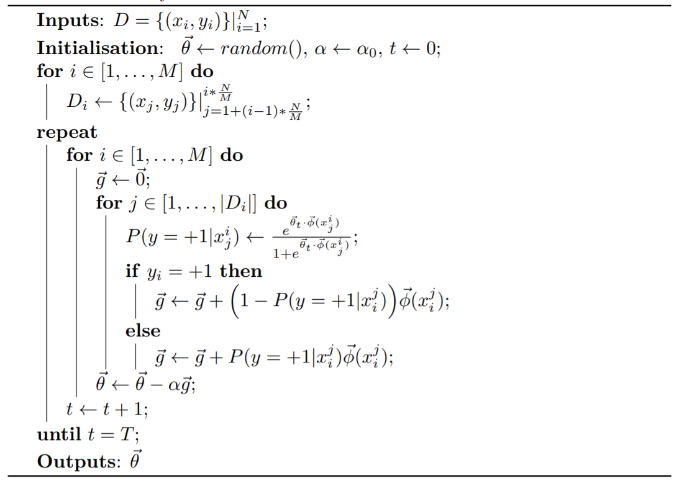
Mini-batch SGD
Mini-batch gradient descent for binary classification

Slide 23
Contents
4.1 Log-Linear Models
4.1.1 Training binary log-linear models
4.1.2 Training multi-class log-linear models
4.1.3 Using log-linear models for classification
4.2 SGD training of SVMs
4.2.1 Binary classification
4.2.2 A perceptron training objective function
4.3 A Generalized Linear Model for Classification
4.3.1 Unified Online Training
4.3.2 Loss Functions
4.3.3 Regularization
4.4 Working with Multiple Models
4.4.1 Comparing model performances
4.4.2 Ensemble models

Slide 24
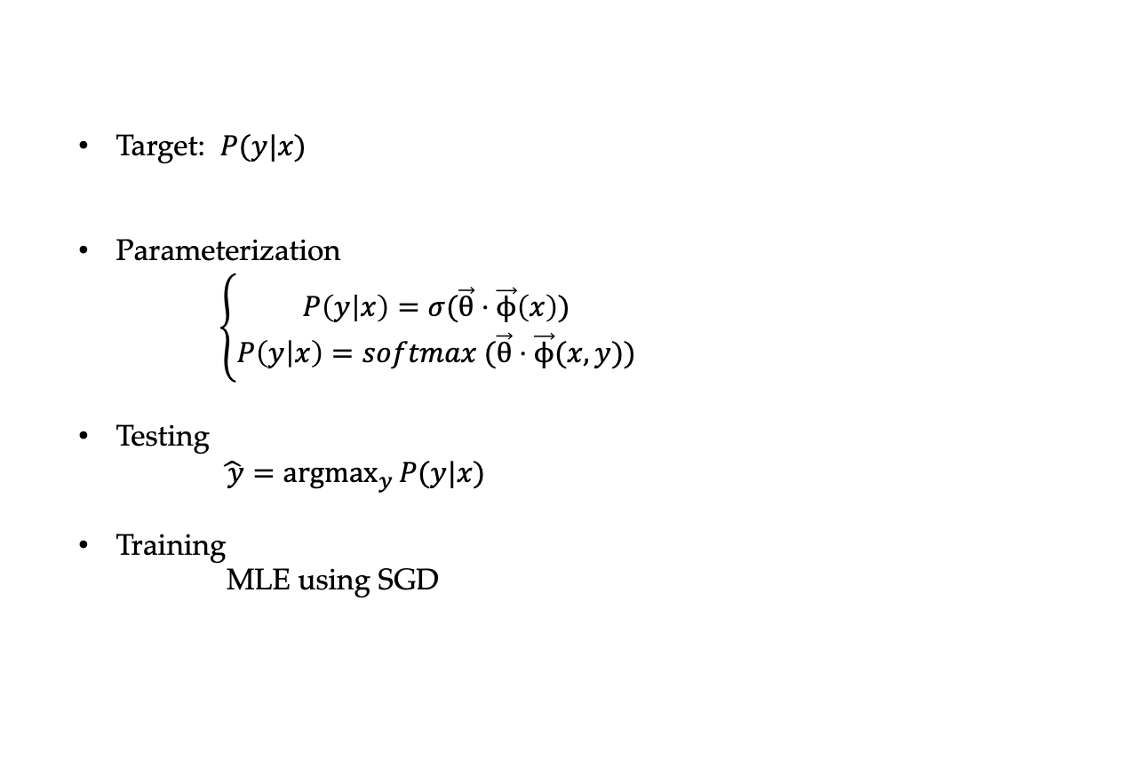
Review log-linear model
Target: $P(y|x)$
Parameterization
$\left\{\begin{aligned}P\left(y | x\right)=σ(\vec{θ}⋅\vec{ϕ}\left(x\right)) \\ P\left(y | x\right)=softmax (\vec{θ}⋅\vec{ϕ}(x,y))\end{aligned}\right.$
Testing
$\hat{ y}=\underset{y}{argmax}{P(y|x)}$
Training
MLE using SGD

Slide 25
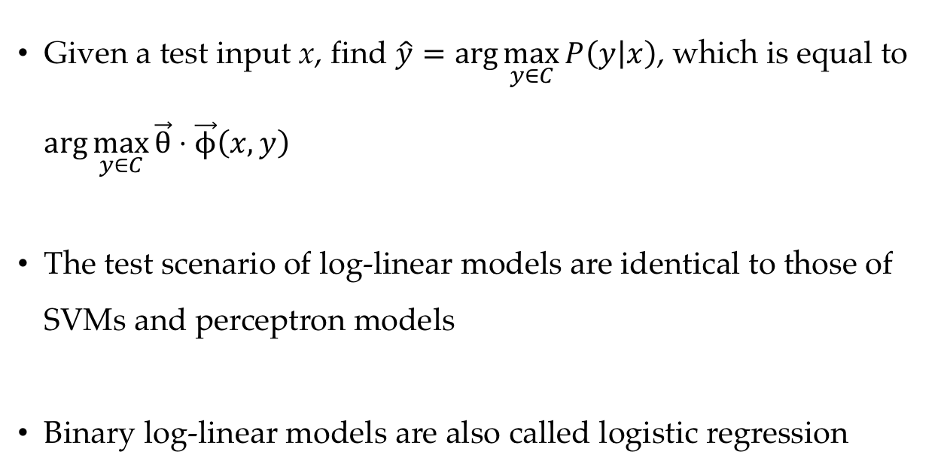
Test scenario of log-linear models
Given a test input x, find $\hat{y}=\arg{\max_{y∈C}{P\left(y | x\right)}}$, which is equal to $\arg{\max_{y∈C}{\vec{θ}⋅\vec{ϕ}\left(x,y\right)}}$
The test scenario of log-linear models are identical to those of SVMs and perceptron models
Binary log-linear models are also called logistic regression

Slide 26
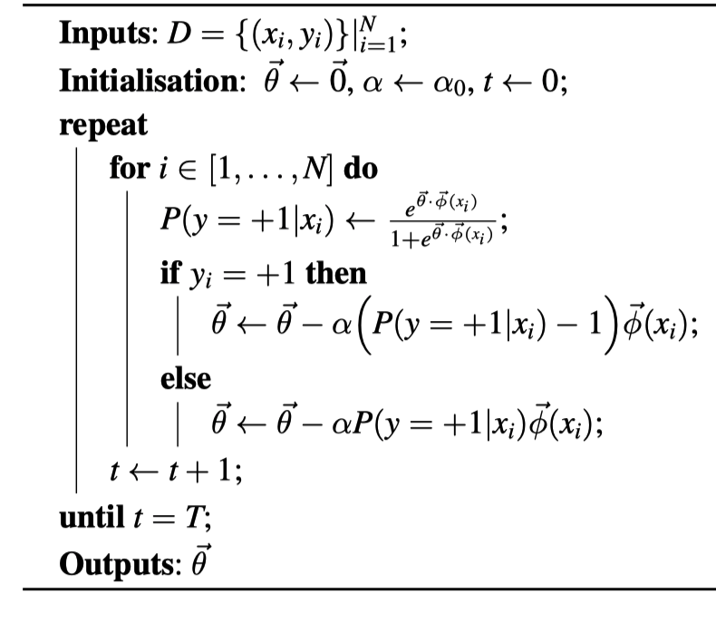
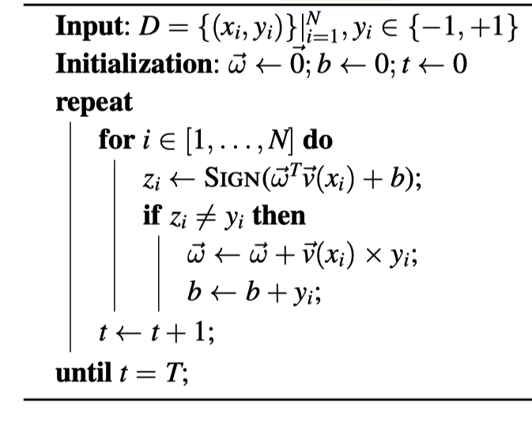
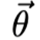
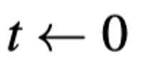

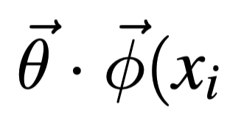
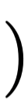
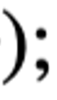
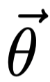
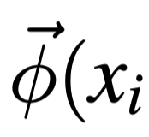

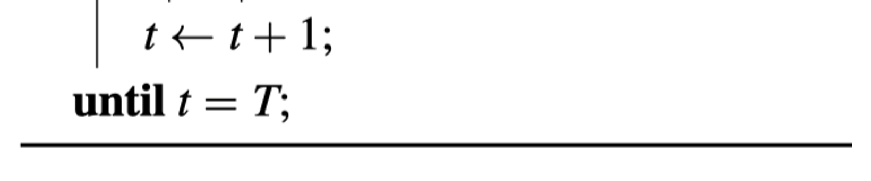
Comparing with Perceptron Binary Classification
binary log-linear models binary perceptron models

Slide 27
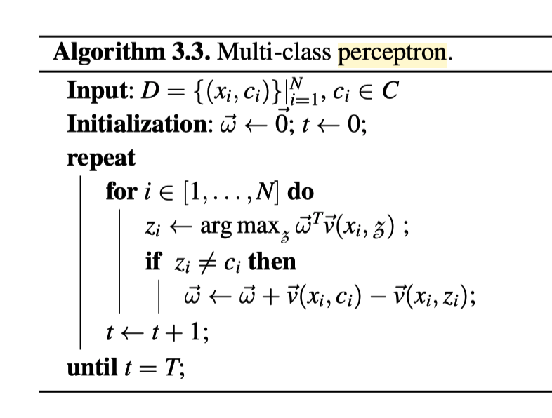
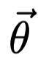
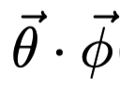
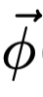
Comparing with Perceptron Multi-class Classification
multi-class log-linear models multi-class perceptron models

Slide 28
Contents
4.1 Log-Linear Models
4.1.1 Training binary log-linear models
4.1.2 Training multi-class log-linear models
4.1.3 Using log-linear models for classification
4.2 SGD training of SVMs
4.2.1 Binary classification
4.2.2 A perceptron training objective function
4.3 A Generalized Linear Model for Classification
4.3.1 Unified Online Training
4.3.2 Loss Functions
4.3.3 Regularization
4.4 Working with Multiple Models
4.4.1 Comparing model performances
4.4.2 Ensemble models

Slide 29
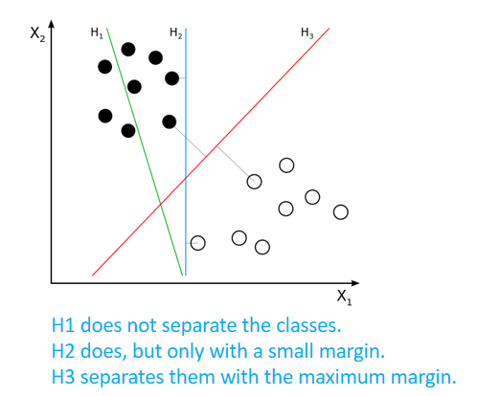
SVM recap
A linear model for binary classification in vector space
To maximize margin (distances form support vectors to hyperplane)
To minimize violation, i.e., ensuring all data residing to the right side
SVM hyperplane
Support vectors
Margins

Slide 30
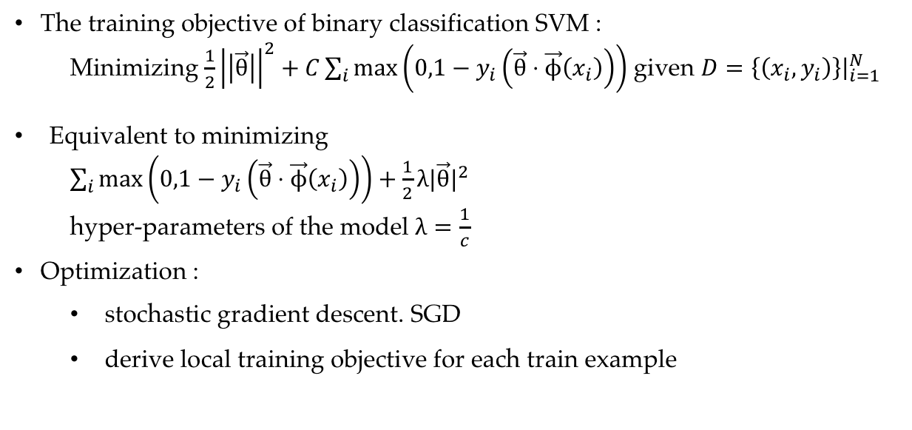
Binary classification SVM
The training objective of binary classification SVM :
Minimizing $\frac{1}{2}{\left|\left|\vec{θ}\right|\right|}^{2}+C\sum_{i}{\max\left(0,1−y_{i}\left(\vec{θ}⋅\vec{ϕ}\left(x_{i}\right)\right)\right)}$ given $D={\left.\left\{\left(x_{i},y_{i}\right)\right\}\right|}_{i=1}^{N}$
Equivalent to minimizing
$\sum_{i}{\max\left(0,1−y_{i}\left(\vec{θ}⋅\vec{ϕ}\left(x_{i}\right)\right)\right)}+\frac{1}{2}λ|\vec{θ}|^{2}$
hyper-parameters of the model $λ=\frac{1}{c}$
Optimization :
stochastic gradient descent. SGD
derive local training objective for each train example
Notes:
Add intuition, plot figure
Slag variable
Maximize margin
Minimize violation
Max function not differentiable

Slide 31
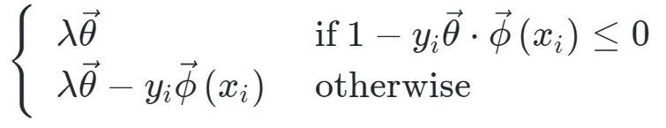
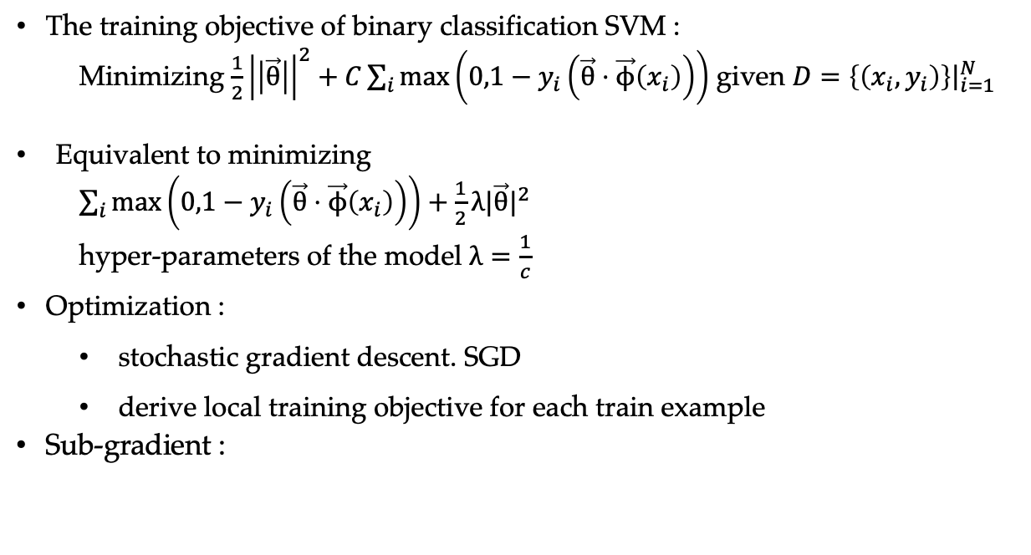
Binary classification SVM
The training objective of binary classification SVM :
Minimizing $\frac{1}{2}{\left|\left|\vec{θ}\right|\right|}^{2}+C\sum_{i}{\max\left(0,1−y_{i}\left(\vec{θ}⋅\vec{ϕ}\left(x_{i}\right)\right)\right)}$ given $D={\left.\left\{\left(x_{i},y_{i}\right)\right\}\right|}_{i=1}^{N}$
Equivalent to minimizing
$\sum_{i}{\max\left(0,1−y_{i}\left(\vec{θ}⋅\vec{ϕ}\left(x_{i}\right)\right)\right)}+\frac{1}{2}λ|\vec{θ}|^{2}$
hyper-parameters of the model $λ=\frac{1}{c}$
Optimization :
stochastic gradient descent. SGD
derive local training objective for each train example
Sub-gradient :
Notes:
Add intuition, plot figure
Slag variable
Maximize margin
Minimize violation
Max function not differentiable

Slide 32
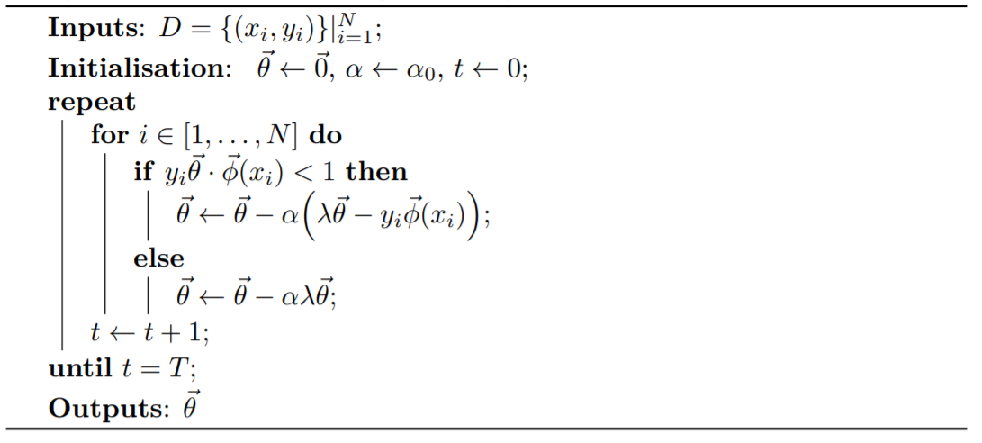
Binary classification SVM
SGD training for binary classification SVM

Slide 33
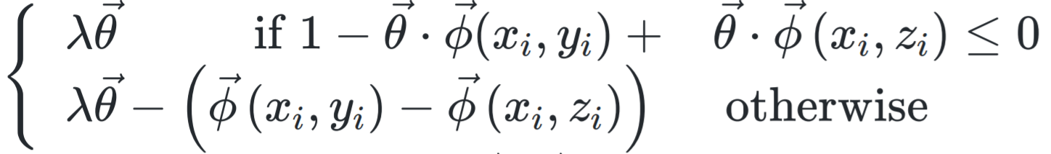
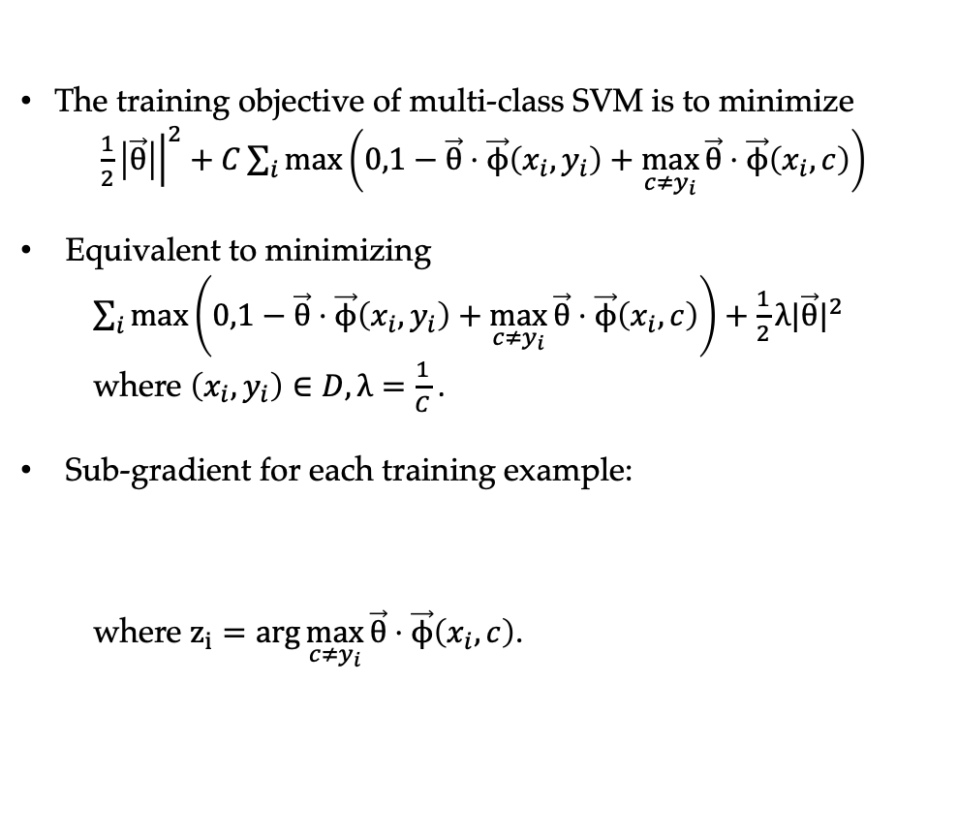
Multi-class classification
The training objective of multi-class SVM is to minimize
$\frac{1}{2}{\left.\left|\vec{θ}\right|\right|}^{2}+C\sum_{i}{\max\left(0,1−\vec{θ}⋅\vec{ϕ}\left(x_{i},y_{i}\right)+\max_{c≠y_{i}}{\vec{θ}⋅\vec{ϕ}\left(x_{i},c\right)}\right)}$
Equivalent to minimizing
$\sum_{i}{\max\left(0,1−\vec{θ}⋅\vec{ϕ}\left(x_{i},y_{i}\right)+\max_{c≠y_{i}}{\vec{θ}}⋅\vec{ϕ}\left(x_{i},c\right)\right)}+\frac{1}{2}λ|\vec{θ}|^{2}$
where $\left(x_{i},y_{i}\right)∈D,λ=\frac{1}{C}$ .
Sub-gradient for each training example:
where $z_{i}=arg\max_{c≠y_{i}}{\vec{θ}⋅\vec{ϕ}\left(x_{i},c\right)}$.

Slide 34
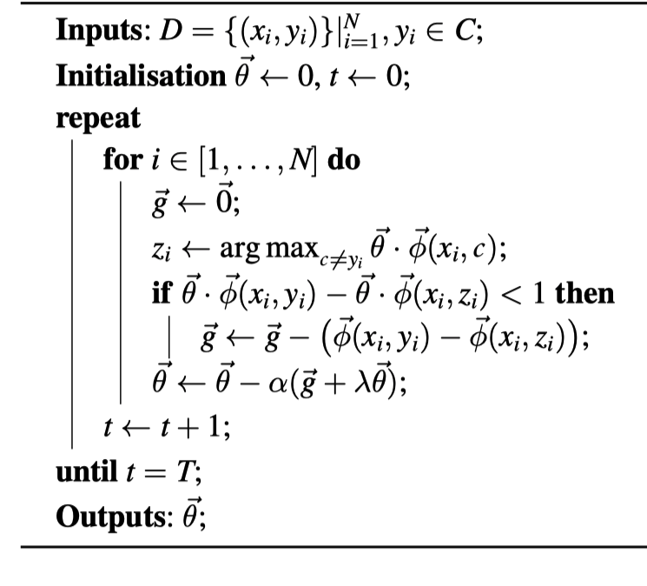
Multi-class classification SVM

Slide 35
Contents
4.1 Log-Linear Models
4.1.1 Training binary log-linear models
4.1.2 Training multi-class log-linear models
4.1.3 Using log-linear models for classification
4.2 SGD training of SVMs
4.2.1 Binary classification
4.2.2 A perceptron training objective function
4.3 A Generalized Linear Model for Classification
4.3.1 Unified Online Training
4.3.2 Loss Functions
4.3.3 Regularization
4.4 Working with Multiple Models
4.4.1 Comparing model performances
4.4.2 Ensemble models

Slide 36
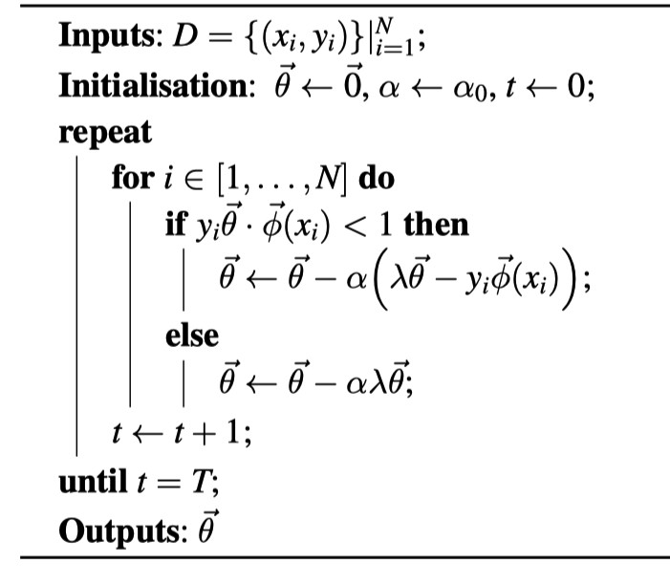
Comparing with Perceptron Binary Classification
binary SVM models binary perceptron models

Slide 37
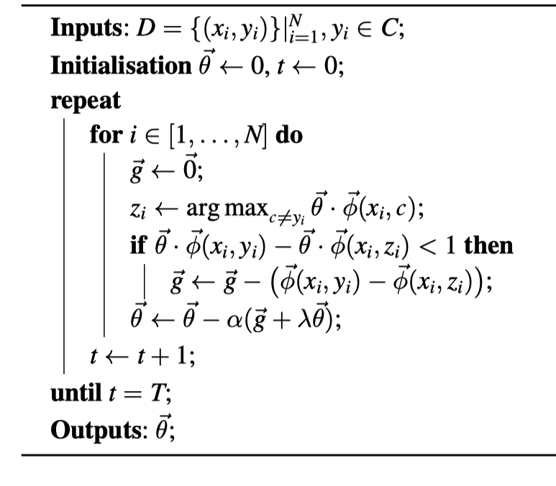
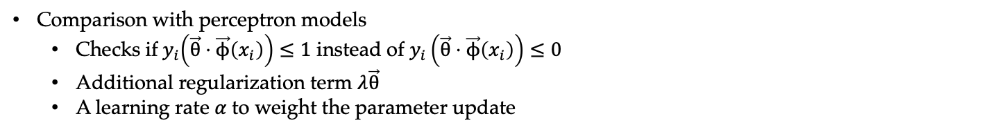
Comparing with Perceptron Multi-class Classification
multi-class SVM models
multi-class perceptron models
Comparison with perceptron models
Checks if${ y}_{i}\left(\vec{θ}⋅\vec{ϕ}\left(x_{i}\right)\right)≤1$ instead of $y_{i}\left(\vec{θ}⋅\vec{ϕ}\left(x_{i}\right)\right)≤0$
Additional regularization term $λ\vec{θ}$
A learning rate $α$to weight the parameter update

Slide 38

A perceptron training objective function
Perceptron updates can also be viewed as SGD training of a certain objective function.
The training objective is to minimize
$\sum_{i=1}^{N}{\max\left(0,−\vec{θ}⋅\vec{ϕ}\left(x_{i},y_{i}\right)+\left.\max_{c}{\vec{θ}}⋅\vec{ϕ}\left(x_{i},c\right)\right)\right.}$
Notes:
Large-margin algorithm

Slide 39
Contents
4.1 Log-Linear Models
4.1.1 Training binary log-linear models
4.1.2 Training multi-class log-linear models
4.1.3 Using log-linear models for classification
4.2 SGD training of SVMs
4.2.1 Binary classification
4.2.2 A perceptron training objective function
4.3 A Generalized Linear Model for Classification
4.3.1 Unified Online Training
4.3.2 Loss Functions
4.3.3 Regularization
4.4 Working with Multiple Models
4.4.1 Comparing model performances
4.4.2 Ensemble models

Slide 40

Generalized linear classification model
Discriminative models
Perceptron
SVM
Log-linear models
Model form identical
$score\left(y | x\right)∝f(\vec{θ}⋅\vec{ϕ}\left(x,y\right)$)
Testing scenario, criteria identical
$y=\arg{\max_{y^{′}}{ score\left(y^{′} | x\right)}}=\arg{\max_{y′}{\vec{θ}}}⋅\vec{ϕ}\left(x,y′\right)$
Training different

Slide 41


Generalized linear classification model
Model and Testing (binary classification case)
parameter vector $\vec{θ}$
feature vector $\vec{ϕ}$
output class label y using the dot product $\vec{θ}⋅\vec{ϕ}$
$f −$activation function

Slide 42
Contents
4.1 Log-Linear Models
4.1.1 Training binary log-linear models
4.1.2 Training multi-class log-linear models
4.1.3 Using log-linear models for classification
4.2 SGD training of SVMs
4.2.1 Binary classification
4.2.2 A perceptron training objective function
4.3 A Generalized Linear Model for Classification
4.3.1 Unified Online Training
4.3.2 Loss Functions
4.3.3 Regularization
4.4 Working with Multiple Models
4.4.1 Comparing model performances
4.4.2 Ensemble models

Slide 43


Unified Online Training
All by SGD training
Given a set of training data $D={\left.\left\{\left(x_{i},y_{i}\right)\right\}\right|}_{i=1}^{N}$, the algorithm goes over D for T iterations, processing each training example $\left(x_{i},y_{i}\right),$and update model parameters when necessary.

Slide 44

Unified Online Training
Parameter Update $(x_{i},y_{i})$ for perceptrons, SVMs and log-linear models

Slide 45
Unified Online Training

Slide 46
Contents
4.1 Log-Linear Models
4.1.1 Training binary log-linear models
4.1.2 Training multi-class log-linear models
4.1.3 Using log-linear models for classification
4.2 SGD training of SVMs
4.2.1 Binary classification
4.2.2 A perceptron training objective function
4.3 A Generalized Linear Model for Classification
4.3.1 Unified Online Training
4.3.2 Loss Functions
4.3.3 Regularization
4.4 Working with Multiple Models
4.4.1 Comparing model performances
4.4.2 Ensemble models

Slide 47

Loss Functions
The training objectives for linear models can be regarded as to minimize different loss functions of a model over a training set.

Slide 48

Different types of loss functions
Hinge loss: the loss functions of SVMs and perceptrons
Log-likelihood loss: the loss functions for log-linear models
0/1 loss: loss is 1 for an incorrect output and 0 for a correct output.

Slide 49

Risks
The true expected risk of a linear model with parameter can be formulated as
$$risk\left(\vec{θ}\right)=\sum_{x,y}{loss\left(\vec{θ}⋅ϕ\left(x,y\right)\right)P\left(x,y\right)},$$
which cannot be calculated, we use empirical risk as a proxy
$\tilde{risk}\left(\vec{θ}\right)=\frac{1}{N}\sum_{i=1}^{N}{loss\left(\vec{θ}⋅ϕ\left(x_{i},y_{i}\right)\right)},\left(x_{i},y_{i}\right)∈D$

Slide 50
Contents
4.1 Log-Linear Models
4.1.1 Training binary log-linear models
4.1.2 Training multi-class log-linear models
4.1.3 Using log-linear models for classification
4.2 SGD training of SVMs
4.2.1 Binary classification
4.2.2 A perceptron training objective function
4.3 A Generalized Linear Model for Classification
4.3.1 Unified Online Training
4.3.2 Loss Functions
4.3.3 Regularization
4.4 Working with Multiple Models
4.4.1 Comparing model performances
4.4.2 Ensemble models

Slide 51


Regularization
SVM training objective
L=
A large element in the parameter vector $\vec{θ}$ implies higher reliance of the model to its corresponding feature, sometimes unnecessarily much.
L2 regularization : $\frac{1}{2}λ{\left|\left|\vec{θ}\right|\right|}^{2}$
and L1 regularization : $λ{\left|\left|\vec{θ}\right|\right|}_{1}$
minimize a polynomial of $\vec{θ}$ in loss functions,
reduce over-fitting of models on given training data.
Notes:
SVM is a Regularized form of perceptron

Slide 52
Contents
4.1 Log-Linear Models
4.1.1 Training binary log-linear models
4.1.2 Training multi-class log-linear models
4.1.3 Using log-linear models for classification
4.2 SGD training of SVMs
4.2.1 Binary classification
4.2.2 A perceptron training objective function
4.3 A Generalized Linear Model for Classification
4.3.1 Unified Online Training
4.3.2 Loss Functions
4.3.3 Regularization
4.4 Working with Multiple Models
4.4.1 Comparing model performances
4.4.2 Ensemble models

Slide 53
Comparing model performances
Different models results from:
different training objectives (large margin or log-likelihood)
different feature definitions
different hyperparameters (number of training iterations, learning rate)
Need to compare accuracies on testset
Can make combination to exploit complementary strengths

Slide 54
Significance test
Model A 93% Model B 92%
Model A is better?
Null hypothesis The probability of null hypothesis – significance level p < 0.01 / p<0.05 / p < 0.001 / p < 0.000001
Use the set of test results to evaluate the probability of null hypothesis.
t-test

Slide 55


Hands on
T test using python and numpy
import the packages
Define 2 random distributions with size N

Slide 56



Hands on
Calculate the standard derivation
Calculate the t-statistics and compare with the critical t-value
Results:

Slide 57

Hands on
Cross checking with the internal scipy function
Results:

Slide 58
Contents
4.1 Log-Linear Models
4.1.1 Training binary log-linear models
4.1.2 Training multi-class log-linear models
4.1.3 Using log-linear models for classification
4.2 SGD training of SVMs
4.2.1 Binary classification
4.2.2 A perceptron training objective function
4.3 A Generalized Linear Model for Classification
4.3.1 Unified Online Training
4.3.2 Loss Functions
4.3.3 Regularization
4.4 Working with Multiple Models
4.4.1 Comparing model performances
4.4.2 Ensemble models

Slide 59

Ensemble models
Ensemble approach: a combination of multiple models for better accuracies.
Voting: a simple method to ensemble different models.
Given a set of models $M=\left(m_{1},m_{2},…m_{\left|M\right|}\right)$ and output classes $C=\left(c_{1},c_{2},…,c_{\left|C\right|}\right),$ the output class y for a given input x can be decided by counting the vote (hard 0/1votes):
$v_{i}=\sum_{j=1}^{\left|M\right|}{b1\left(y\left(m_{j}\right),c_{i}\right)}$
majority voting chooses the class label that receives more than half the total votes
plurality voting chooses the class with the most votes.
More fine-grained voting methods are soft voting and weighted voting.

Slide 60

Ensemble models
Stacking:
use the outputs of one model as features to inform another model.
Training for stacking
the stacking method trains A after B is trained.
We use K-fold jackknifing to make model B output accuracies on the training data as close to the test scenario as possible.

Slide 61

Ensemble models
Bagging use different subsets of D to obtain different models and then ensemble them. Voting is then performed between models given a test case. Bagging can outperform a single model for many tasks.

Slide 62
Co-training and self-training
Data augmentation.
Semi-supervised learning use different models trained on D to predict the labels on a set of unlabeled data U, augmenting D with the outputs that most models agree on.
the more accurate the baseline models are on U, the more likely that the new data form U can be correct and useful.

Slide 63


Co-training

Slide 64

Self-training

Slide 65
Summary
Log-linear models for binary and multi-class classification
Stochastic Gradient Descent (SGD) training of log-linear models and SVMs
A generalized linear discriminative model for text classification
The correlation between SVMs, perceptrons and log-linear models in terms of training objective (loss) functions and regularization terms
Significance testing
Ensemble methods for integrating different models

